Slide 1
RPI
MARKET
PLACE
Team FireTrucks
Tim, Robert, Mikah, Satyam, Shivani

Slide 2
OUR IDEA

Slide 3
A Marketplace by students, for students
Platform for RPI students to buy, sell, trade, and auction goods and services.
Create postings for items or services to sell.
Request odd jobs for others to sign up to complete.
User login with RPI email to access features.
Only other alternatives are Facebook Groups or Discord servers.
Notes:
Satyam

Slide 4
FEATURES
Homepage
Profile/login
Goods
auctions/giveaways
Services
favorites
Browse new listings and see your Favorites
View your listings, ratings, and past purchases
View goods that are available for purchase
Participate in auctions and giveaways
View services that are available for purchase
Tag favorites for quick reference
Notes:
Mikah

Slide 5
stakeholders
Students / parents
Faculty / staff
alumni
Sell extra items from previous semesters
Find essentials while being on campus
Less waste, more $$$
Host giveaways to draw attention
Sell items which students desire
Offer students unique services
Offer tutoring services
Connect with current students to learn about RPI changes
Sell old items to benefit RPI directly
Notes:
Tim

Slide 6
Technologies
HTML/CSS
Javascript
php
MySql(MariaDb)
Create the frontend
Make an interactive website
Connect the backend with our database
Store posting and user data
Notes:
Shivani

Slide 7
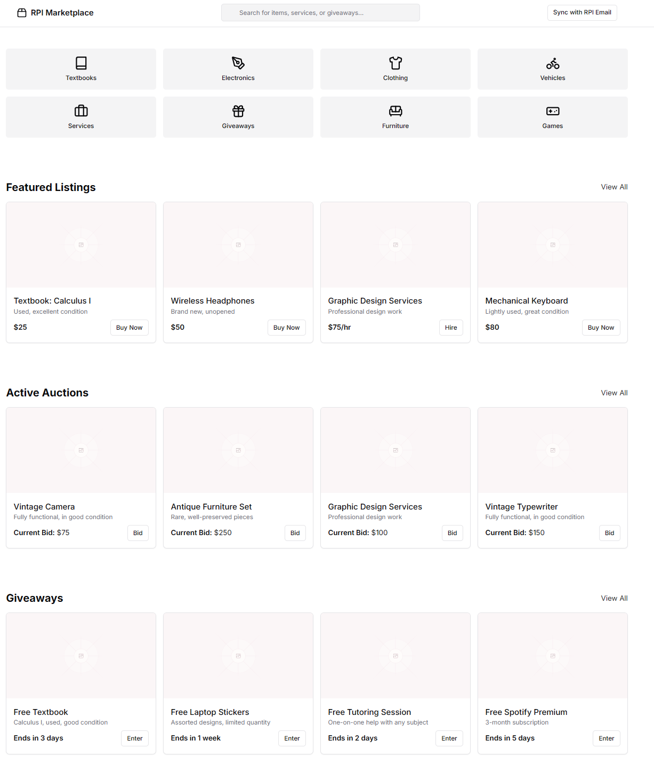
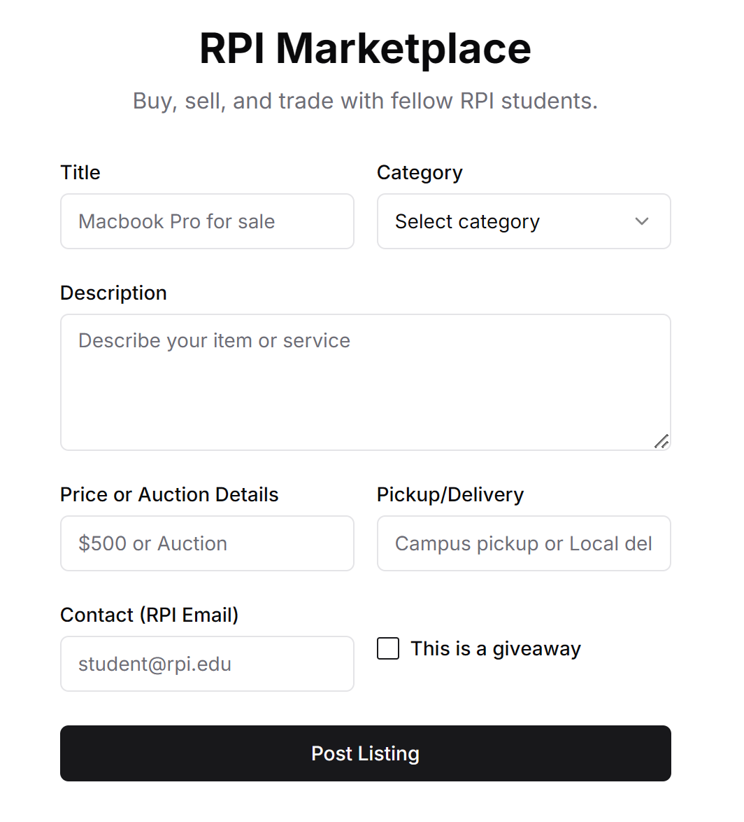
Notes:
Robert

Slide 8
Why rpi marketplace?
Convenient
streamlined
The marketplace’s scope would be limited to around campus so retrieving bought goods or performing services are easily accessible.
Everything will be organized and finding what you want or need will be easier.

Slide 9
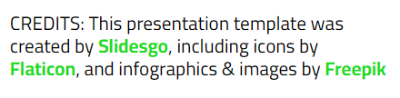
Thank you
Any questions?

